Slide 1


Modelling the Spread of Complaints Among Police Officers
Jeremy Chan

Slide 2
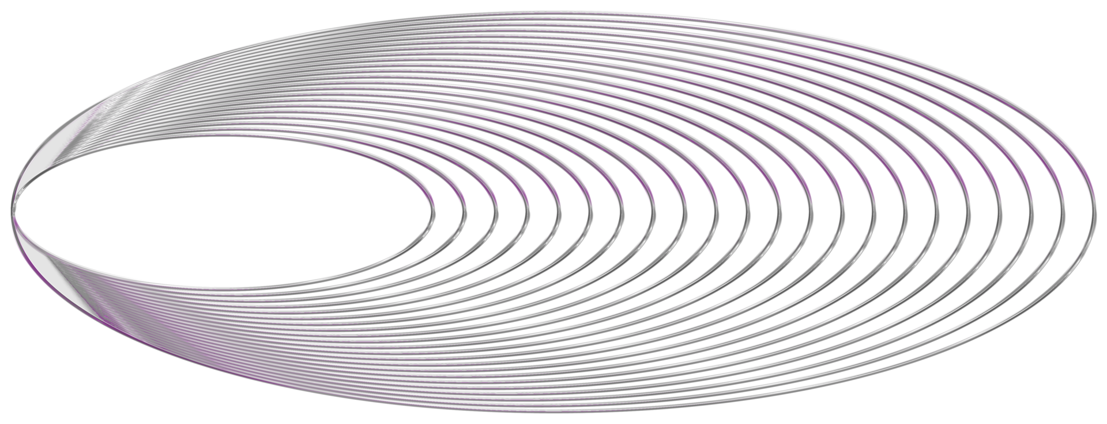
Introduction

Slide 3
Introduction
More attention towards police brutality and their use-of-force
Roughly 600,000 to 700,000 U.S. residents claimed to have experienced police contact involving less-than-lethal force
75% to 83% reports of excessive force
Research suggest that violence could be contagious
Could Police use-of-force misconduct be contagious?

Slide 4
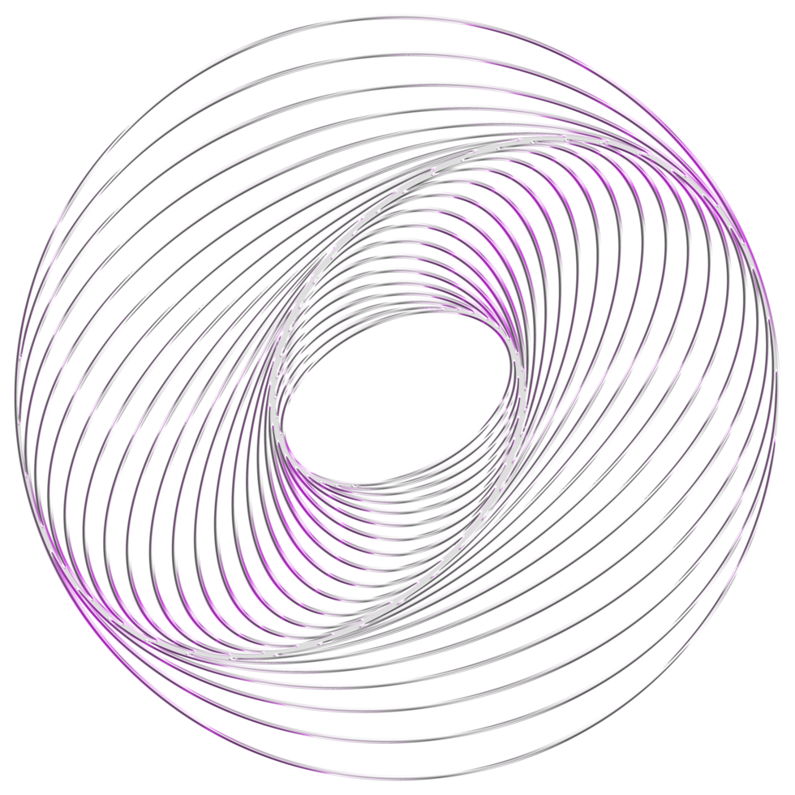
Literature Review

Slide 5
Literature Review
Violence as Social Contagion
Infectious population disease
Treating violence as an infectious disease would be effective
Social networks influence gang violence
Gang turf, prior conflict etc
Is Social Contagion a Factor in Police Networks?
Ongoing debate
Notes:
Papachristos' 2019 study found that officers with a higher proportion of co-accused with a history of excessive force complaints were more likely to be involved in such complaints.
Chalfin's 2021 study countered Papachristos' findings, advocating for early warning systems to deter problematic behavior and promote accountability.
Papachristos responded to Chalfin's study, arguing that removing problem officers is important and interpreting their results as consistent with other interventions to reduce police complaints.
Simpson and Kirk's 2022 study on Dallas police officers indicates that misconduct is associated with an officer's past behavior, officer-specific proneness, neighborhood context of patrol, and, in some cases, officer race, but not with the disciplined misbehavior of their ad hoc partners. The study suggests that interventions targeting individual officers and early interventions focused on new offenders may be effective in curbing police misconduct.
The role of social contagion in police excessive force remains a topic of debate, with limited research on the distribution of complaints among police officers.
The experiments conducted support the prevalence of social contagion in police networks and highlight the importance of understanding social dynamics to design effective interventions for promoting accountability and deterring problematic behavior.

Slide 6
Literature Review
Some research done on why police use excessive force
Many officers believe they can go above and beyond the law when necessary
Psychological, Sociological, and Organizational theories
Racial Bias
Notes:
These factors include the presence of a full-time internal affairs department,
in-service training, violent crime rates in the area, academy performance, off-duty
incidents, etc.
Clustering, spread, and transmission factors
Susceptibility, exposure, incubation

Slide 7
Literature Review
Predicting Police Violence
Multiple factors
Data not freely available to the public, not always tracked at all departments
Cannot verify if homogeneous across time and location

Slide 8
Methodology

Slide 9
Methodology
Resampling Test
Pólya Urn Model
Spillover Pólya Urn Model

Slide 10
Null Hypothesis
Null Hypothesis:
Probabilities of officers who receive excessive use of force complaints are equal
Officers who receives complaints are randomly chosen

Slide 11

What is the Resampling Test
Random Selection of Officers
Algorithm:
Initialize officers to have same probability/weight
T = Total Number of officers in a police beat
Randomly select officers to receive complaints
Increment their count
Repeat until all incidents are accounted for

Slide 12
Officer IDs in a Beat | 1024, 19, 229, 717, 830, 1218, 824, 32, 1114, 420
Incident 1 | 1024, 19, 229, 717, 824, 32
Incident 2 | 1024, 19, 229, 830, 1218
Incident 3 | 830, 1218, 1114
T | 10 Officers
Initial Weight | 0.1
Number of Complaints (Everyone starts off having 1) | Number of Officers
2 (Selected Twice) | 1024, 19, 229, 830, 1218
1 (Selected Once) | 1114, 717, 824, 32
0 (Not Selected) | 420
Resampling Test Example

Slide 13
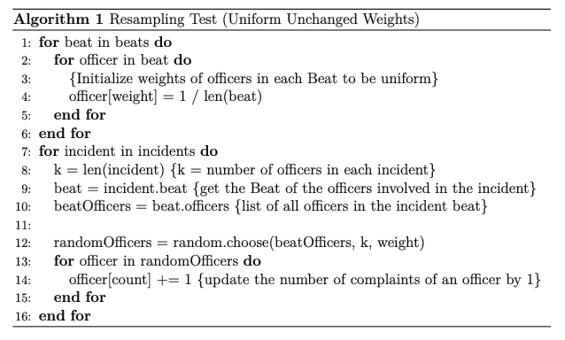
Resampling Test Pseudocode

Slide 14
What is the Pólya Urn Model
In reality not all officers are equally likely to receive complaints
Have to adjust the weights of officers dynamically
Introduce a parameter alpha (α)
Algorithm:
Initialize weights like the Resampling Test
Select officers using their probability/weight
If officer is selected, add α to their weight
Repeat until all incidents are accounted for

Slide 15
Officer IDs in a Beat | 1024, 19, 229, 717, 830, 1218, 824, 32, 1114, 420
Incident 1 | 1024, 19, 229, 717, 824, 32
Incident 2 | 1024, 19, 229, 830, 1218
Incident 3 | 1024, 830, 1218, 1114, 420
T | 10 Officers
Initial Weight | 0.1
α | 0.2
Number of Complaints (Everyone starts off having 1) | Number of Officers
3 (Selected Thrice) | 1024
2 (Selected Twice) | 19, 229, 830, 1218
1 (Selected Once) | 1114, 717, 824, 32, 420
Pólya Urn Model Example

Slide 16
Officer 1024
6 Officers in Incident 1
5 Officers in Incident 2
Initial Weight | 0.1
After Incident 1 | (0.1 + 0.2) / (1 + 0.2 * 6) ≈ 0.14
After Incident 2 | (0.3 + 0.2) / (1 + 0.2 * 6 + 0.2 * 5) ≈ 0.16
After Incident 3 | (0.5 + 0.2) / (1 + 0.2 * 6 + 0.2 * 5 + 0.2 * 5) ≈ 0.17
Final Weight | 0.17
5 Officers in Incident 3
Pólya Urn Model Example

Slide 17
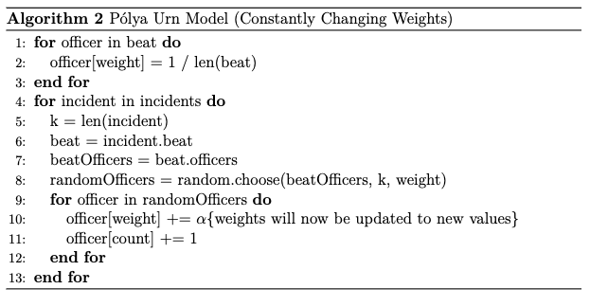
Pólya Urn Model Pseudocode

Slide 18

What is the Spillover Pólya Urn Model
Instead of just adding α to officers, consider the history of other officers
New parameter beta (β)
1 - β is the proportion an officer’s weight is affected by other officers in an incident
Accounts for social contagion
Weight of incident officers affects future weight of each other
Weight update formula:
Notes:
Right summation part is the average weights of the other officers before the incident occurs

Slide 19
Weight Update Formula

Slide 20
Officer 1024
α = 0.2, β= 0.4
New Officer Weight = 0.4 * (0.1 + 0.2) + (1 - 0.4) / (6 - 1) * [(0.1 + 0.2) * 5]
= 0.3
Weight Update Example

Slide 21
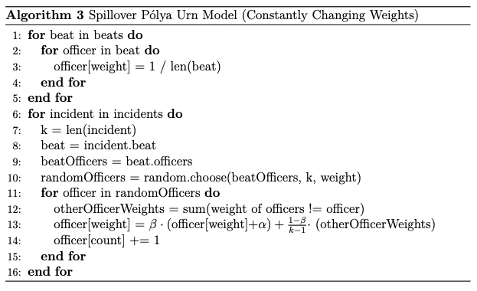
Spillover Pólya Urn Model Pseudocode

Slide 22
Data

Slide 23
Invisible Institute: Citizens Police Data Project (CPDP)
Nonprofit journalism production company in Chicago
Maintain open-source datasets widely available to the public
CPDP
Complaints towards Police officer in the Chicago Police Department (CPD)
https://cpdp.co/
Time Frame: 2000 - 2016

Slide 24
Data Preprocessing
Assumptions
Accuracy of information cannot be guaranteed
GitHub Repository can be found at: https://github.com/invinst/chicago-police-data
Officers with at least one complaint were included in the dataset
Filtered out only use-of-force complaints
Counted number of occurrences for each officer using their OfficerID
Mapped the beat of each officer to their Officer ID

Slide 25
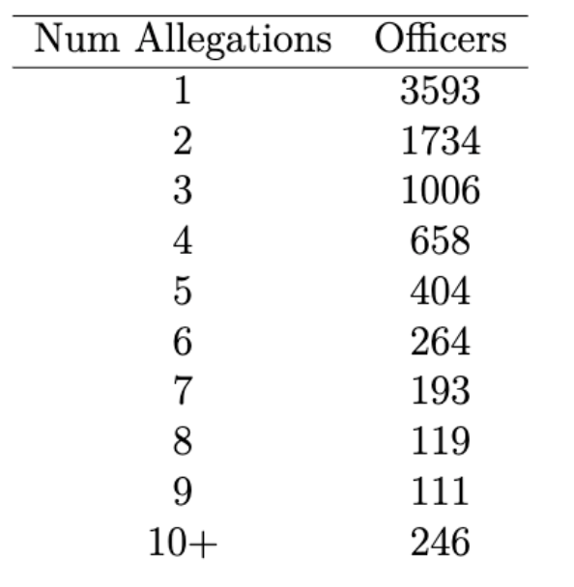
Initial Distribution of Values

Slide 26
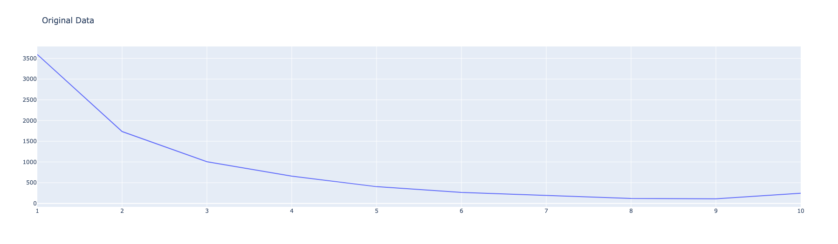
Original Distribution of Officer Complaints

Slide 27
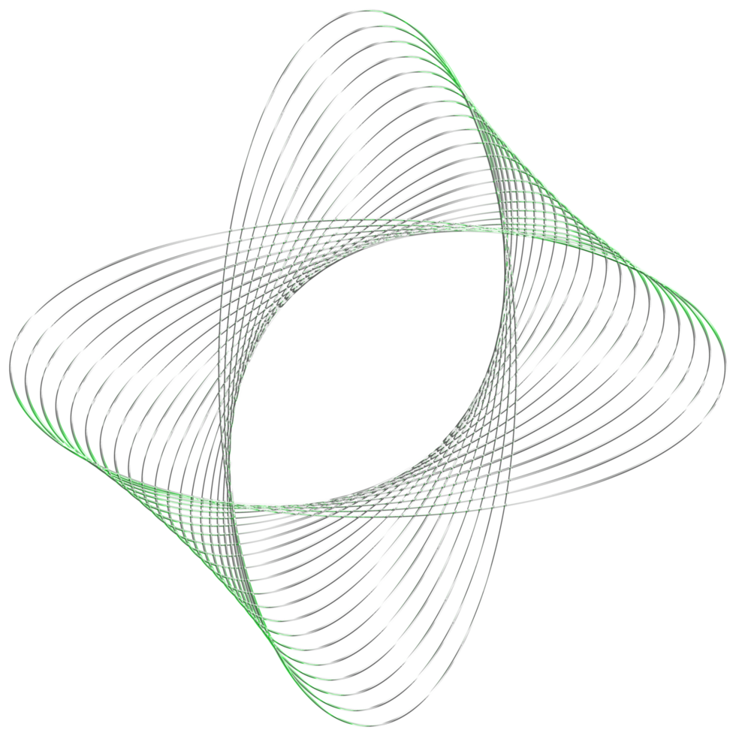
Experiment & Results

Slide 28
Setup
1000 simulations for each algorithm
Python (NumPy, Pandas, Plotly)
For finding parameters α and β, took the best value over 1000 trials
Mean Squared Error as Cost Function
α = 0.2, β = 0.4
95% Confidence Interval
GitHub Repository:
https://github.com/Jeremyhudsonchan/Undergraduate-Thesis

Slide 29
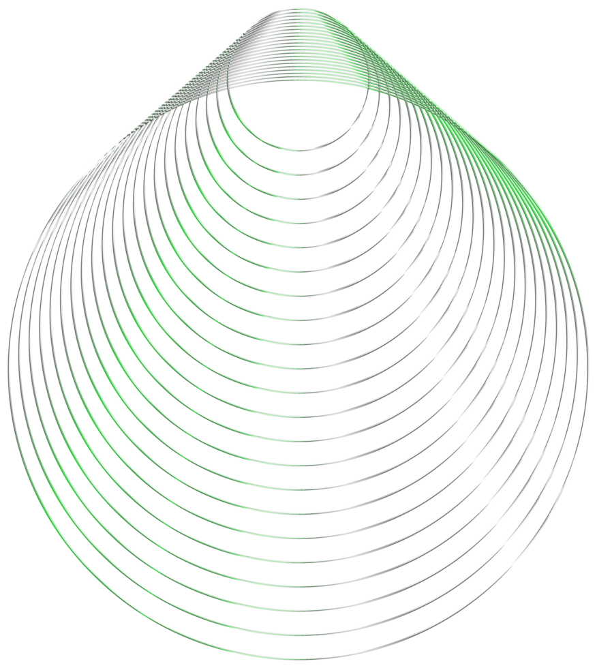
Resampling Test

Slide 30
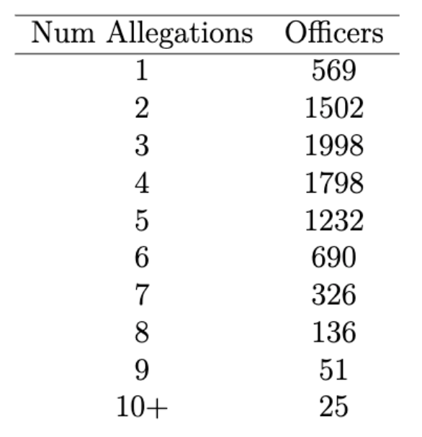
Original Distribution
Resampling Test

Slide 31
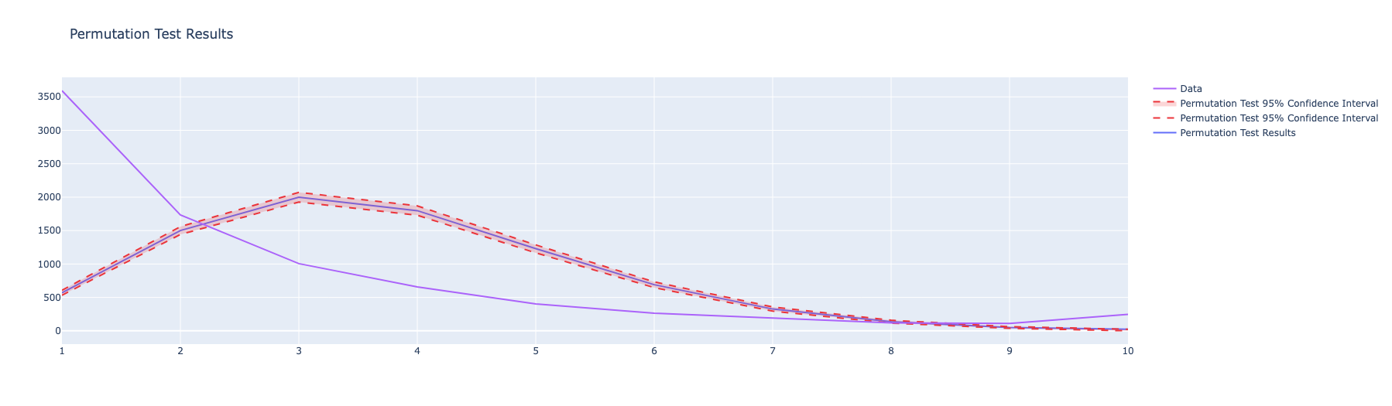
Original Data vs Resampling Test
Notes:
Reject the Null Hypothesis
We have the independent randomly resampled curve, it overestimates officers in the 3 to 6 range, while for the intervals 1 and 10 it underestimates it
Does not follow the original distribution of data, shows that randomly sampling is not what is happening here

Slide 32
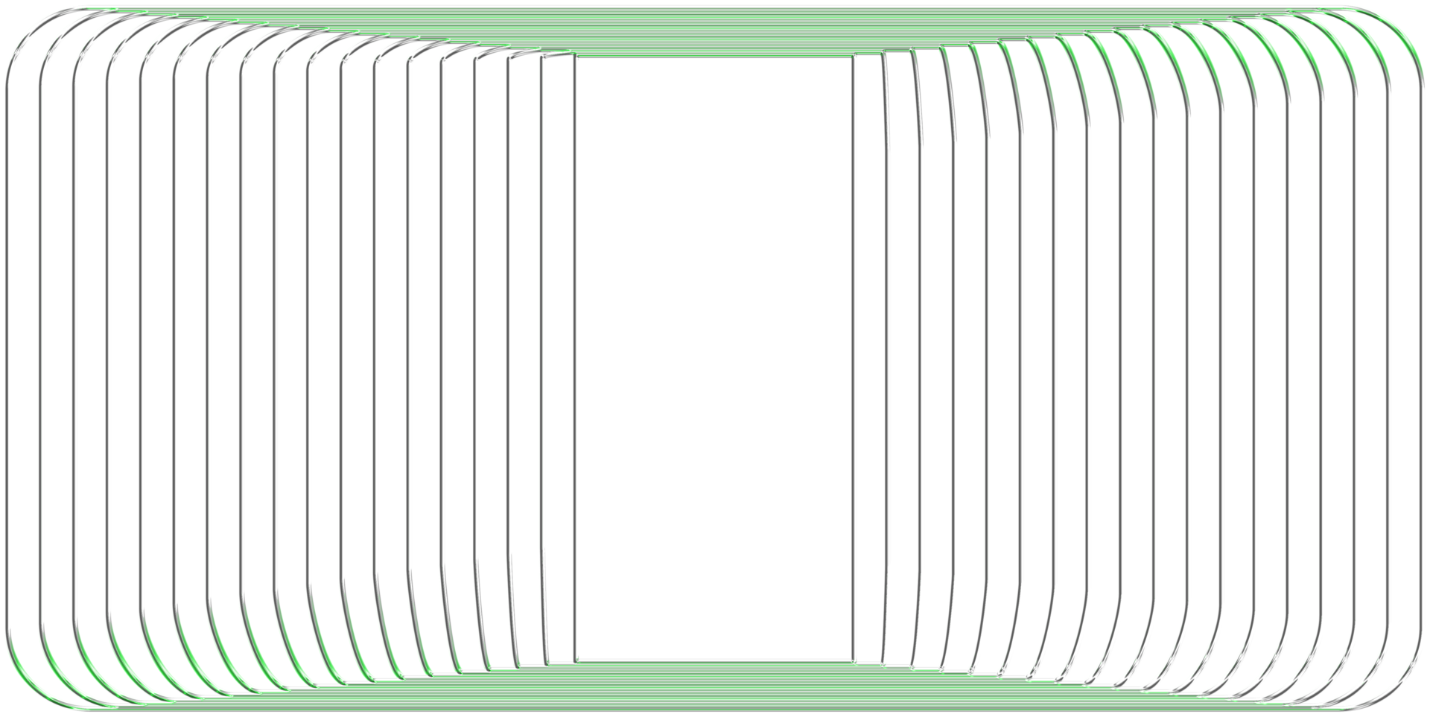
Pólya Urn Model

Slide 33
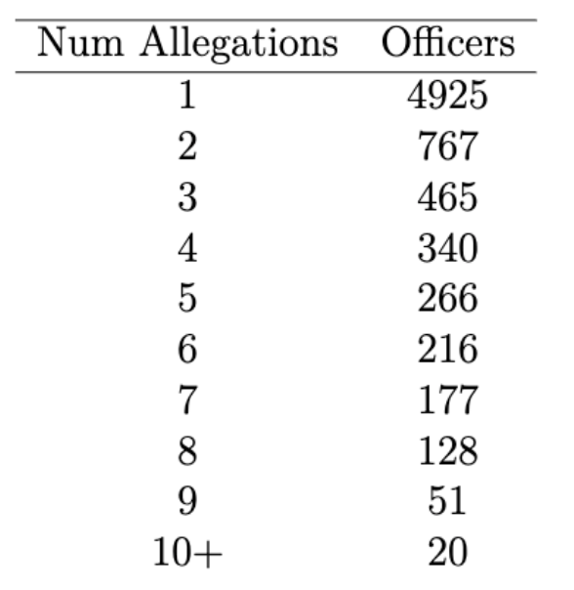
Original Distribution
Pólya Urn Model

Slide 34
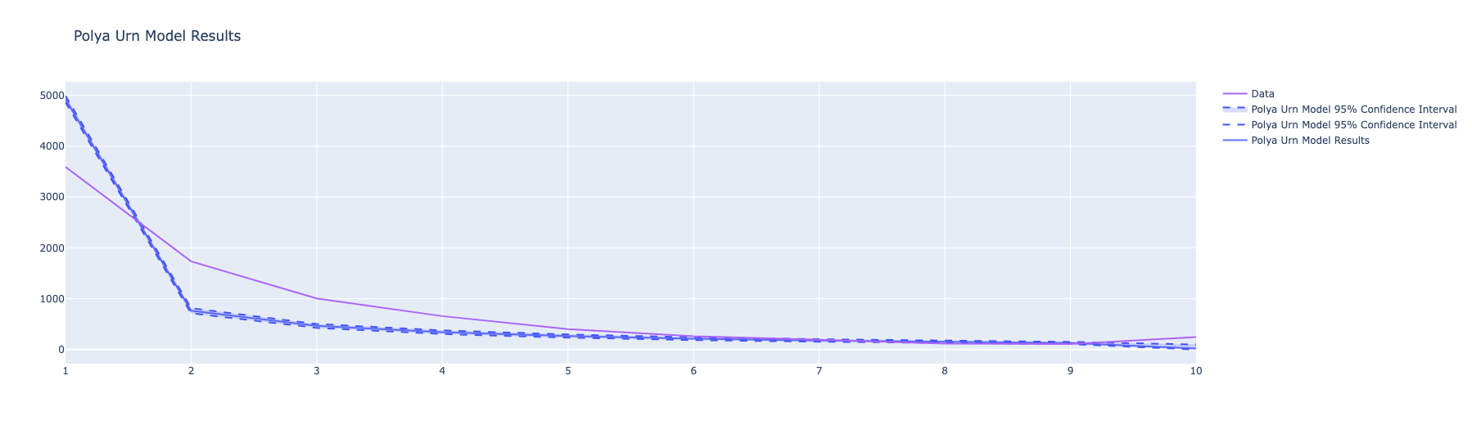
Original Data vs Pólya Urn Model
Notes:
Self-contagion fits better, but overestimates the number of officers with 1 complaint
Self-contagion could play a role

Slide 35
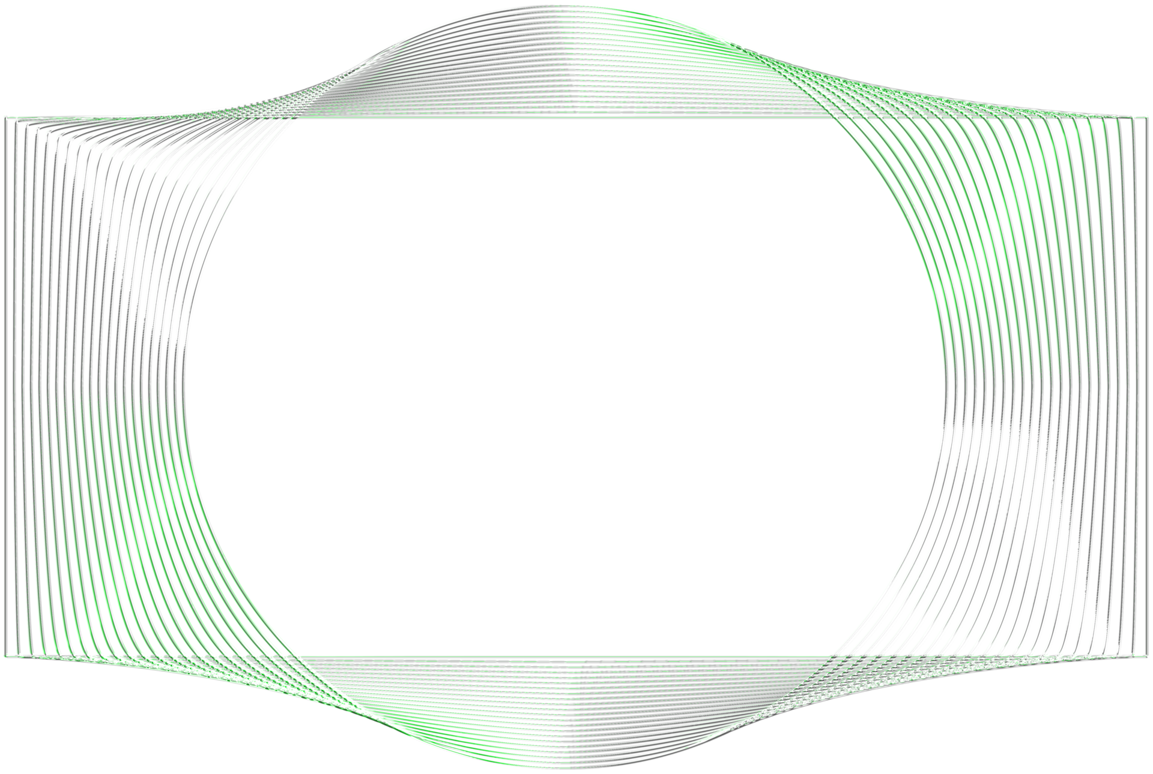
Spillover Pólya Urn Model

Slide 36
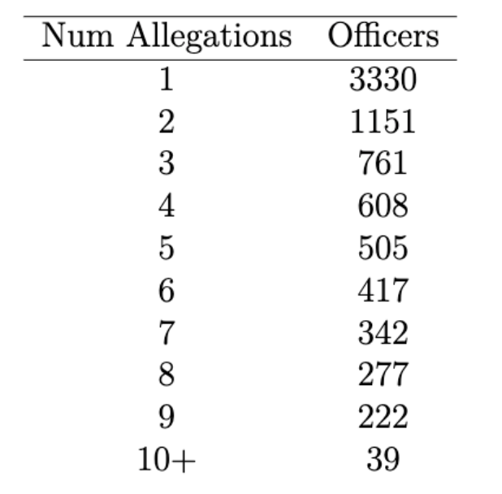
Original Distribution
Spillover Pólya Urn Model

Slide 37
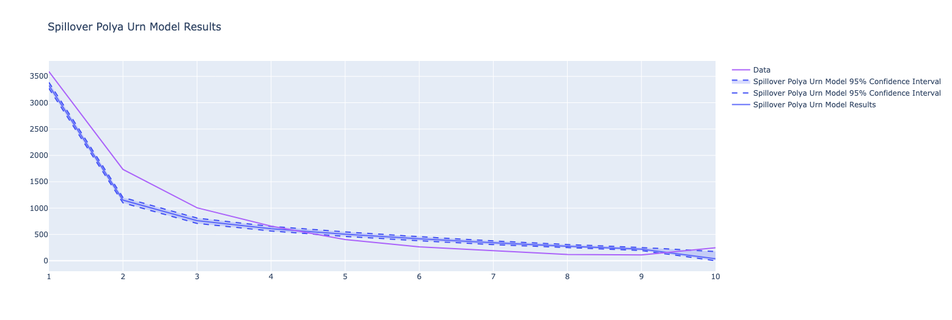
Original Data vs Spillover Pólya Urn Model

Slide 38

Conclusion & Future Work

Slide 39
Conclusion
Spillover Pólya Urn Model > Pólya Urn Model > Resampling Test
Supports the idea of excessive use of force being contagious in police networks
Contributes to the current debate

Slide 40
Limitations
One dataset
One timeframe
Used existing incident sizes

Slide 41
Future Work
Better data collection methods
Research using other datasets
Check if algorithms are transferable
Different Methods
Point Processes Models
Hawkes Model
Graph Based Techniques
Graph Neural Networks
Notes:
On-duty pairings
Performance in academy
Number of internal complaints
Inter-department cases
Time check out sheets

Slide 42
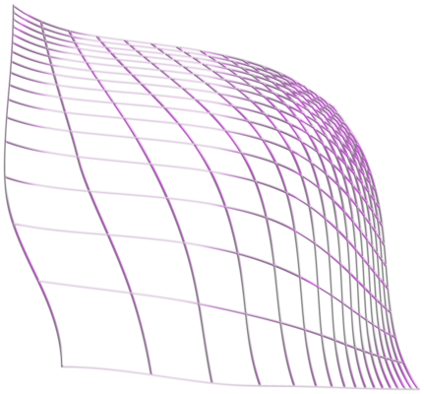
Thank you!

